Slide 1
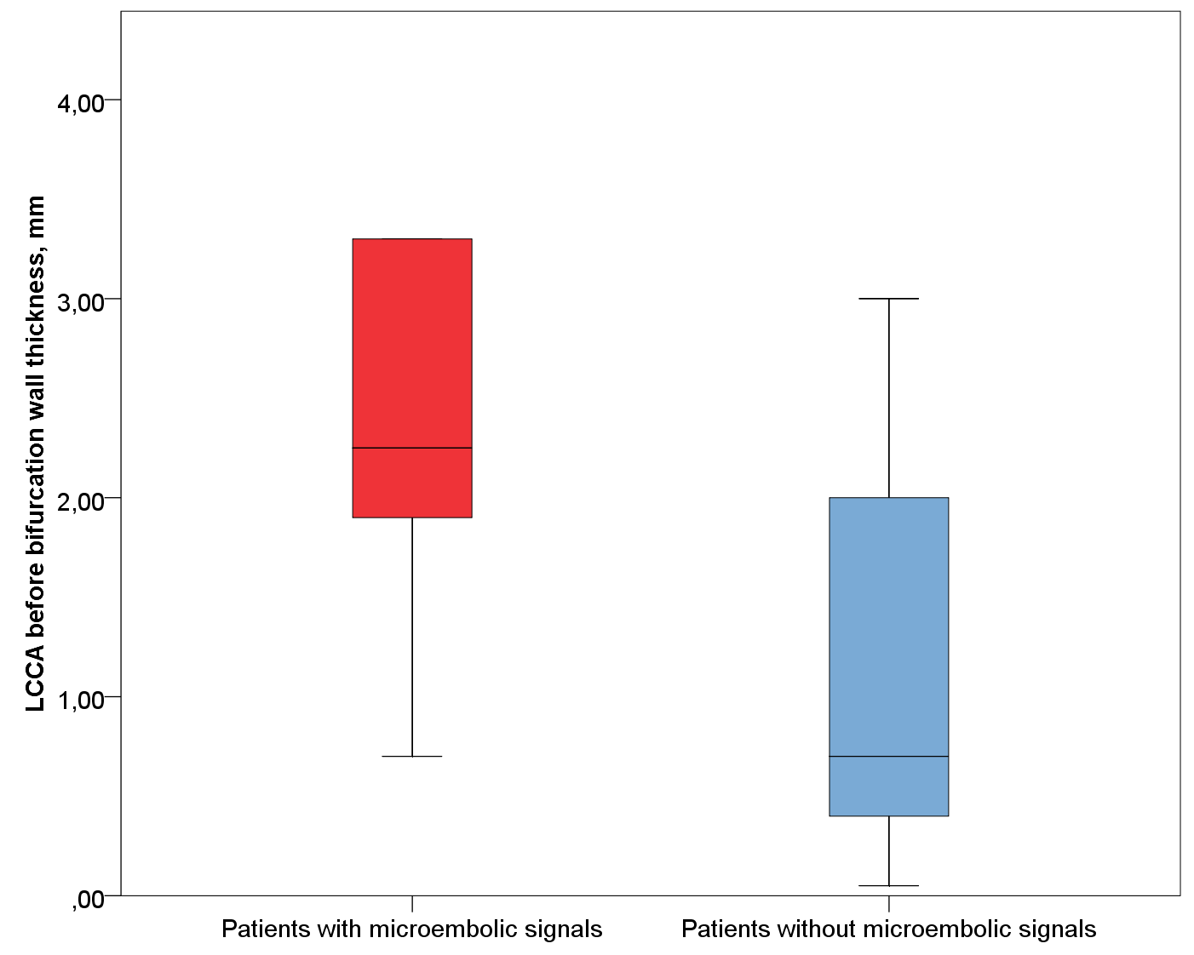
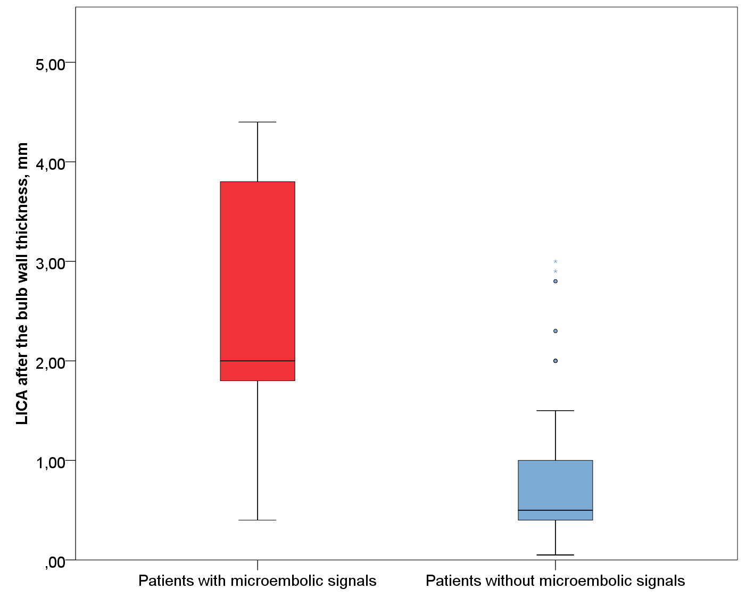
MICROEMBOLIC SIGNALS IN PATIENTS AT RECOVERY PERIOD OF ISCHEMIC STROKE
Berdalin A., Medvedkova E., Golovin D., Vishnyakova A., Gubsky. I., Lelyuk V.
Radiology and clinical physiology research center of Federal State Budgetary Institution “Federal center of brain research and neurotechnologies” of the Federal Medical Biological Agency
Introduction
Results
Transcranial doppler embolodetection is a non-invasive, reproducible method for emboli detection in the cerebral arteries bloodstream. Prevailing opinion is that microemboli usually do not cause the clinical symptoms, but are markers and predictors of macroembolism. Another point of view: prolonged massive microembolization has a cumulative effect and leads to vascular dementia. Detection of microemboli within three months after a stroke may be a predictor of recurrent stroke and death. Despite the prognostic value of recorded microembolic signals (MES), their pathogenetic role is not fully understood. The aim of this study was to compare patients with and without MES in the late recovery period of IS to identify clinical and diagnostic parameters, associated with MES.
According to brain MRI data in patients with MES, the limbic system atrophy on the right side (MTA scale) was significantly greater than in patients without MES (p=0.017). On the left side, a similar picture was observed (p=0.13).
In patients with MES, the frequency and severity of deep microbleeds was significantly higher (p=0.045).
Vascular wall thickness (atherosclerotic plaque height) according to MSCTA was higher in patients with MES, for example: brachiocephalic trunk 4.00+/-1.48mm and 1.88+/-1.49mm, respectively (p=0.002); right CCA - 2.90+/-2.18mm and 1.18+/-1.30mm (p=0.006); left CCA - 2.23+/-1.50mm and 1.33+/-1.13mm (p=0.072); left ICA bulb 3.49+/-1.76mm and 1.79+/-1.32mm (p=0.003) (additionally - Fig 1-2).
Methods
We include 515 patients with ischemic stroke. MES in MCA or PCA were observed in 48 (9.3%) patients, in 467 (90.7%) MES were not detected. All patients underwent: brachiocephalic arteries duplex scanning, echocardiography, microembolodetection, brain MRI, brain MSCT.
We aquire data on the presence and severity of WML by Fazekas scale, the presence and severity of microbleeds, the cerebral cortex local atrophy severity, assess the presence and severity of atherosclerotic lesions of the brachiocephalic arteries, linear and volumetric blood flow velocities, diameters of the carotid, vertebral arteries, basilar artery and intracranial arteries.
Statistical analysis was performed using SPSS Statistics version 25.0. ANOVA or Fisher's exact test was.
Figure 1. Vascular wall thickness (atherosclerotic plaque height) of left CCA before bifurcation; p=0.014
Figure 2. Vascular wall thickness (atherosclerotic plaque height) of left ICA after the bulb; p=0.004
Discussion & Conclusion
MES in our patients were associated with wall thickness in the CCA and ICA, atherosclerosis in the ascending aortic arch. There was no connection with cardiac pathology, concomitant diseases, defects in the plaque lining. The main cause of MES in our cohort is atherosclerosis, possibly aortic.

